Slide 1

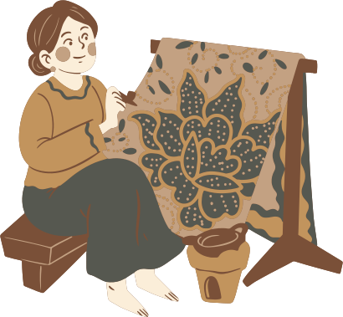
Batik
An Artistic Tradition of Indonesia

Slide 2

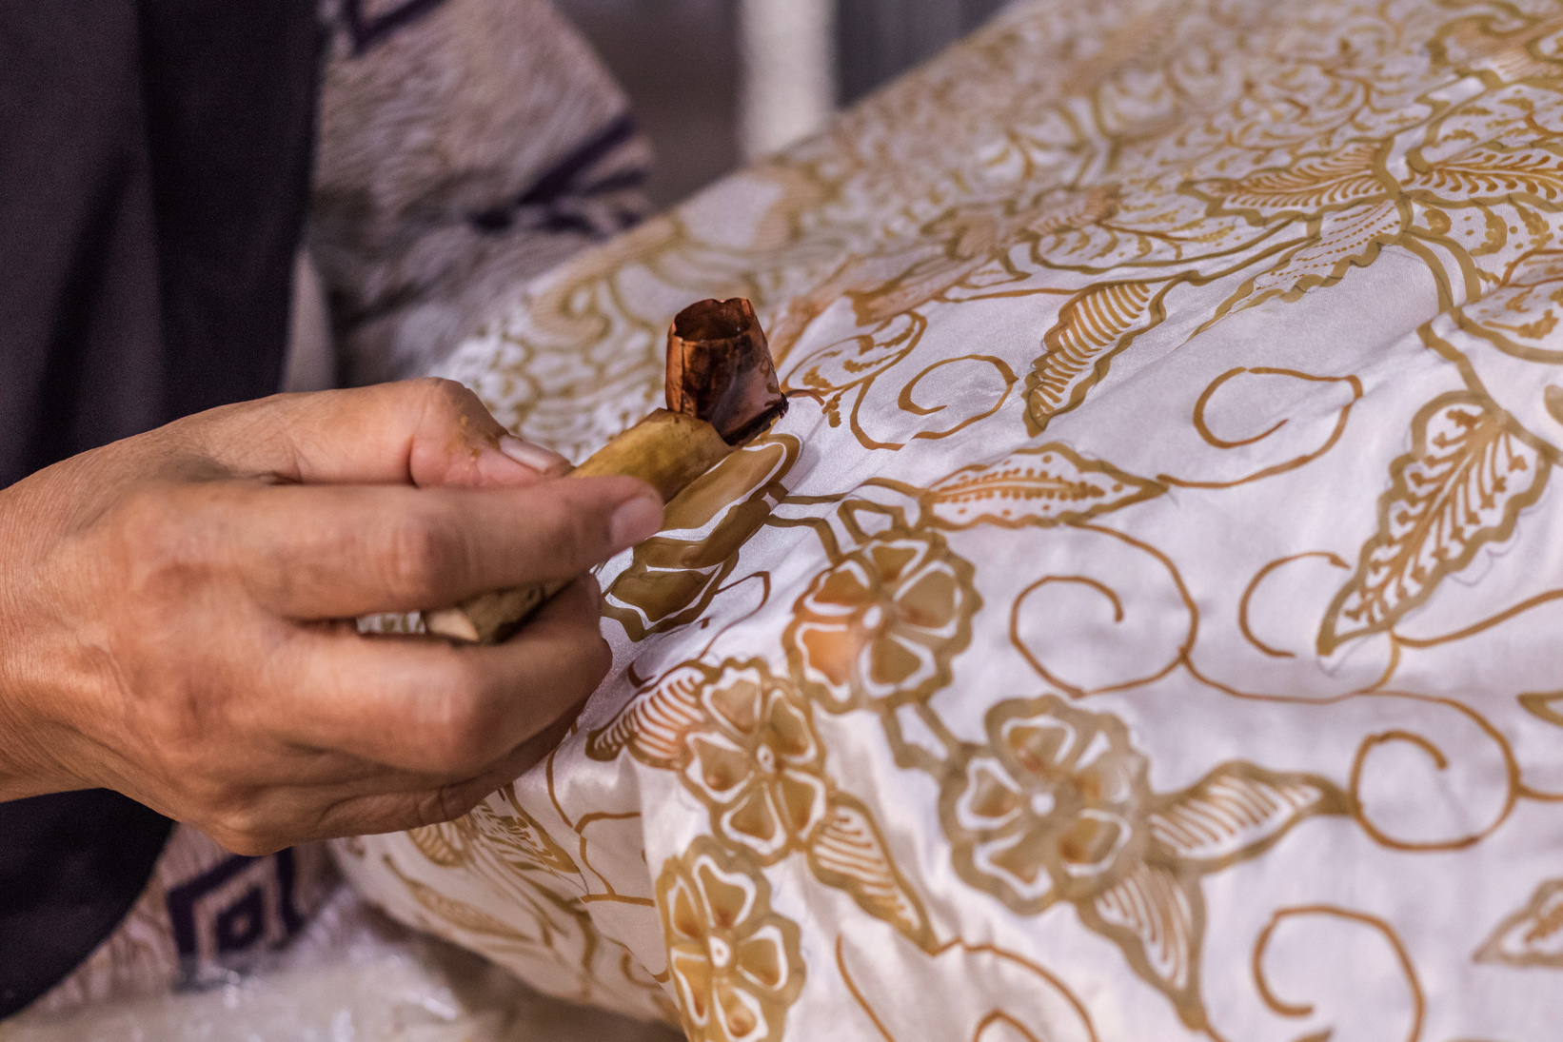
What is Batik?
Definition: Batik is a traditional Indonesian art form using wax-resist dyeing on cloth.
Recognised as a Masterpiece of Oral and Intangible Heritage of Humanity.
It is not just fabric, but a rich cultural expression.

Slide 3
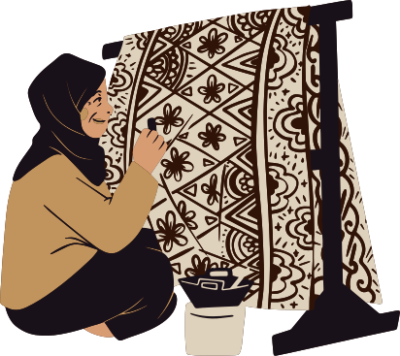
History of Batik
Ancient practice dating back to 6th century in Indonesia.
Rooted in the island of Java, influenced by traders from India and China.
Batik gained prominence in royal courts.
Spread from royal to common circles in the 19th and 20th centuries.

Slide 4
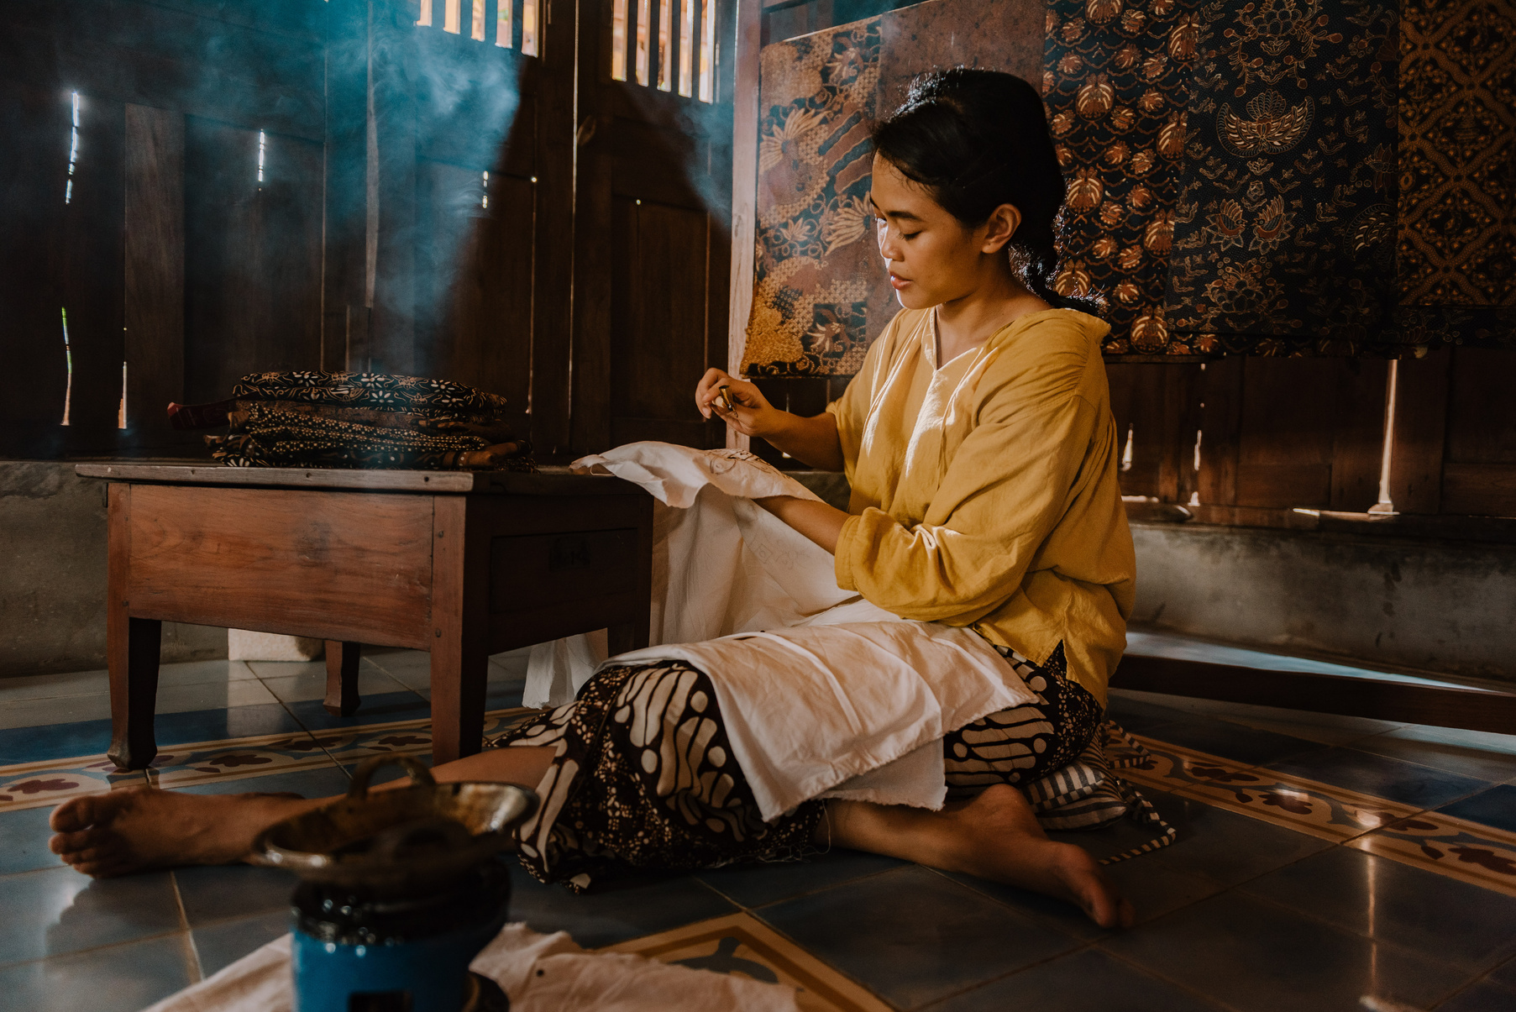
The Batik Making Process
Materials and Tools
Wax, natural dyes, copper stamps (cap), and canting (a pen-like tool).
Tools
Canting: A tool for hand-drawn patterns.
Cap: A copper stamp for repetitive patterns.

Slide 5

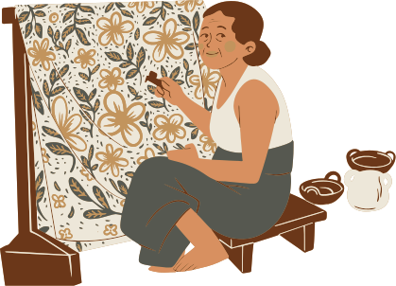
The Batik Making Process
Step-by-Step Process
Designing the pattern.
Wax application: Hand-drawn or stamped.
Dyeing the fabric.
Wax removal.
Final touches.

Slide 6
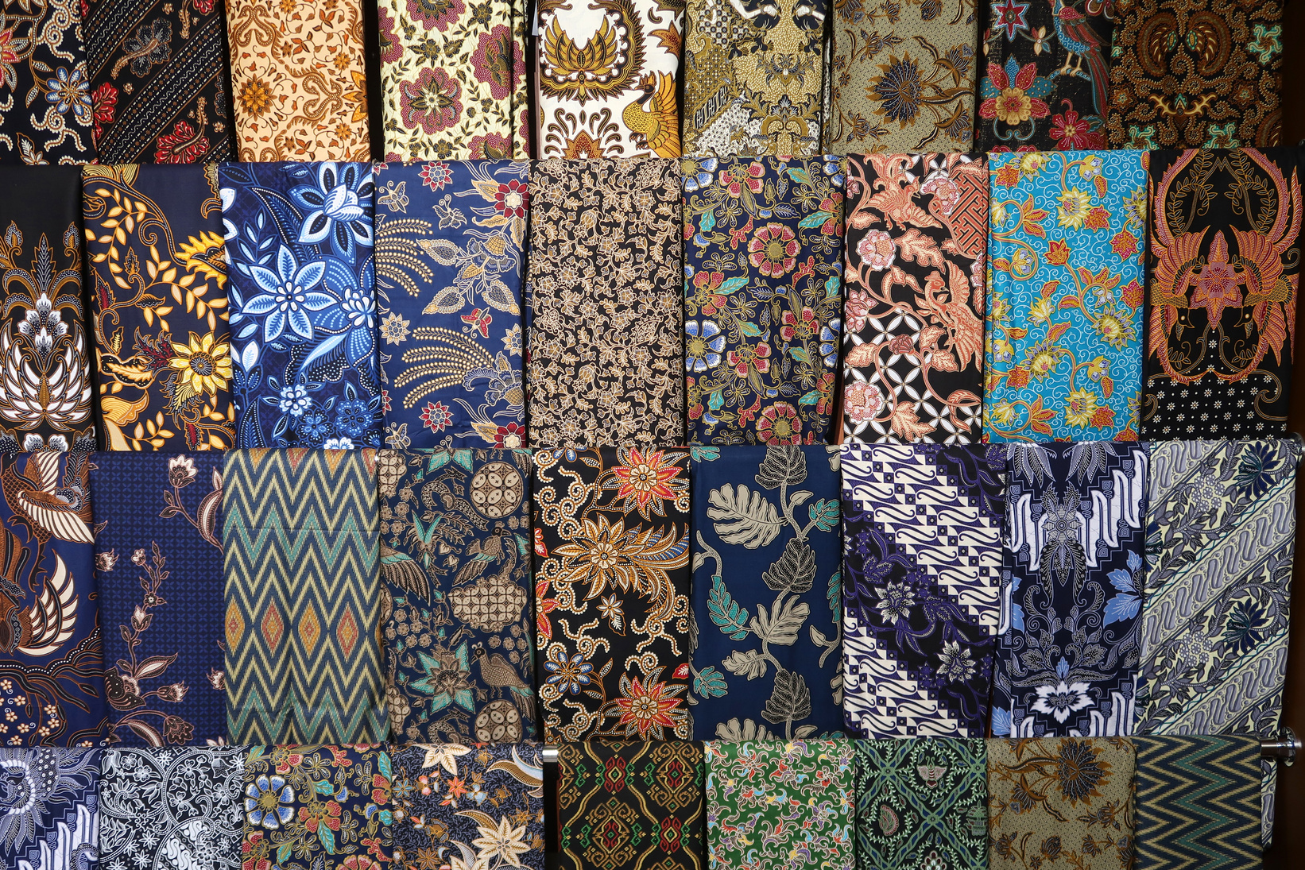
Types of Batik Patterns
Traditional Motifs
Parang: Symbolizes strength.
Kawung: Represents justice and wisdom.
Regional Differences
Javanese Batik: Often uses earthy tones like brown, black, and indigo.
Batik from Bali, Sumatra: Brighter colors, more floral and animal motifs.

Slide 7
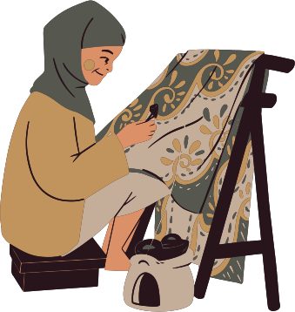
Symbolism in Batik
Cultural and Social Significance
Motifs often signify status, identity, and power.
Some designs are reserved for royalty .
Specific patterns are used in ceremonies like weddings, funerals, and religious rituals.
Spirituality and Philosophy
Patterns often depict deep spiritual meanings related to harmony, life, and the cosmos.

Slide 8
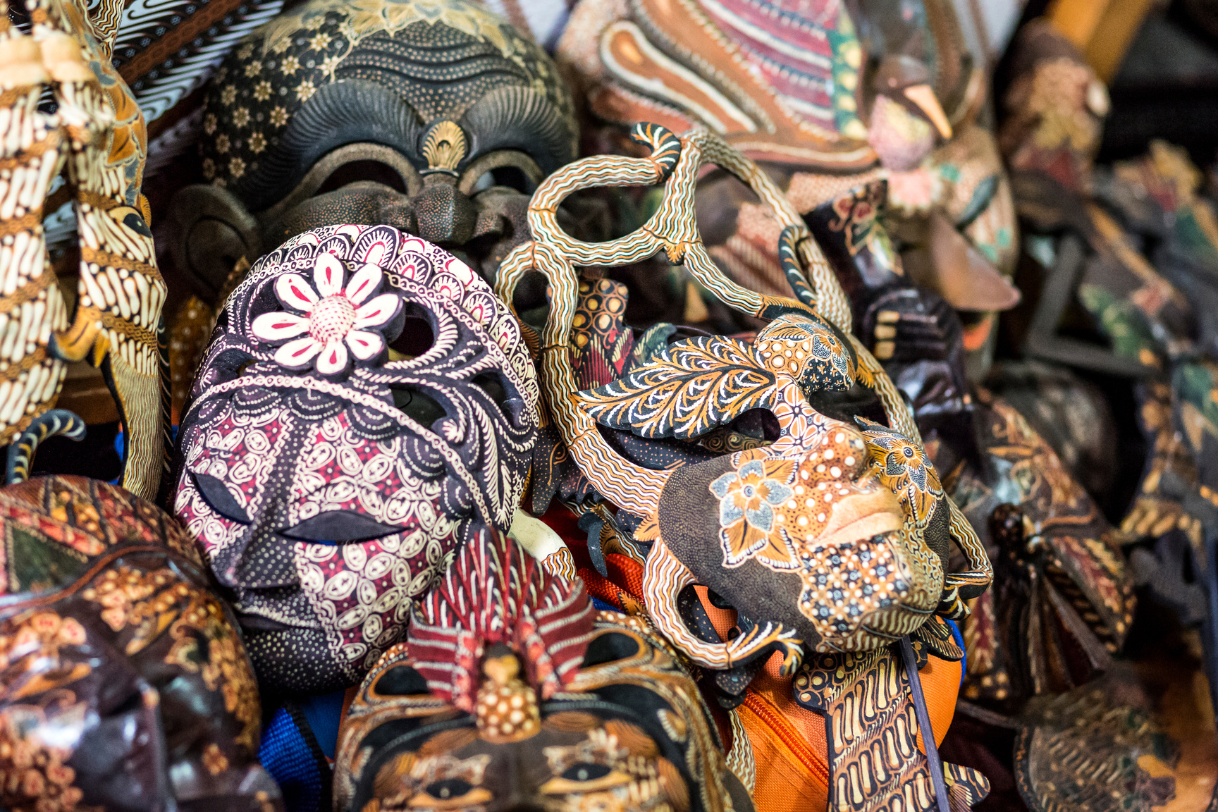
Batik in Modern Times
Batik has gained worldwide attention as a fabric for high fashion and contemporary design.
Global designers have integrated Batik into their collections.
Revival efforts by artisans to keep the traditional process alive.

Slide 9
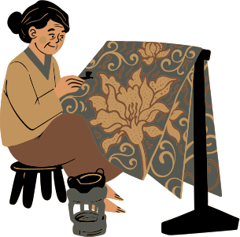
Batik’s Role in Indonesian Identity
National Pride
Celebrated annually on Batik Day (October 2).
Worn by Indonesians as a symbol of national identity.
Economic Impact
Batik industry supports local artisans and small businesses.
Exported worldwide, contributing to the economy.

Slide 10
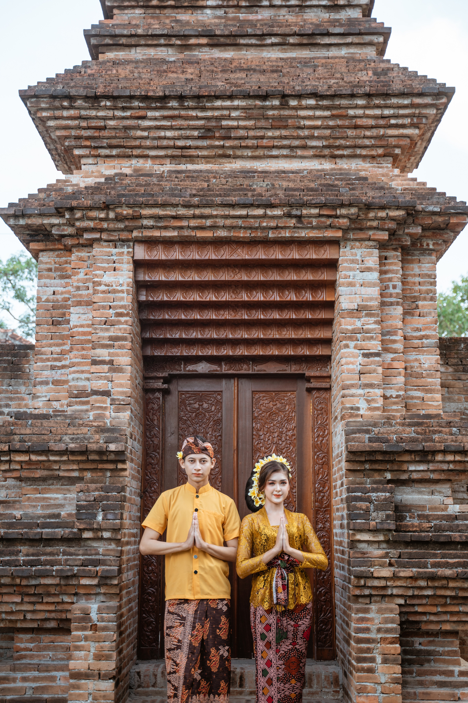
Thank You

